Slide 1





Slide 2
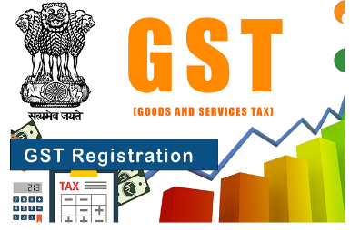

Slide 3

Agenda
Basic
Existing Tax Regime
Current Tax Regime
GST Overview
Pan card formatting
GST Registration Applicability and benefits
Type of Registration
IVR
LOB
Languages available on IVR
ZTP Policies

Slide 4

Basic Information
Gst Portal URL – https://www.gst.gov.in/
Gst Help-Desk Number (365*7) 9:00 AM To 9:00 PM – 1800-103-4786 ( Toll-Free)
Grievance Redressal Portal for GST – https://selfservice.gstsystem.in/
E-Way bill Portal Link – https://ewaybillgst.gov.in/
E-Invoice Portal Link – https://einvoice1.gst.gov.in
CBIC Help-Desk Toll Free No – 18001200232 (For GST/Eway bill legal Information)
( No more available )
Email ID – cbecmitra.helpdesk@icegate.gov.in
(For Any legal Information)
( No more available )
Tax officer Help-Desk Number – 0124-4479900
Ice-gate Help-Desk Number – 1800-3010-1000

Slide 5
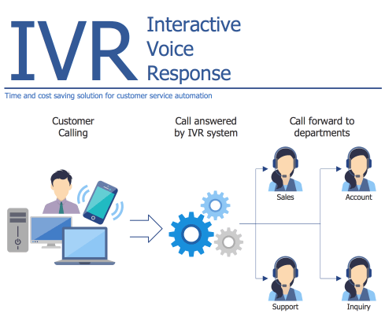
What is IVR
Interactive Voice Response (IVR) is an automated phone system technology that allows incoming callers to access information via a voice response system of pre recorded messages without having to speak to an agent, as well as to utilize menu options via touch tone keypad selection or speech recognition to have their call routed to specific departments or specialists.

Slide 6

Languages on IVR
Hindi
English
Bengali
Gujrati
Telegu
Tamil
Assamese
Oriya
Malayalam
Marathi
Kannad
Punjabi

Slide 7
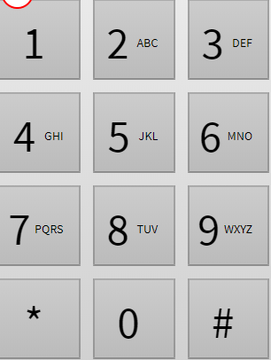
Options on IVR
Language | Options on IVR
Hindi | 1
English | 2
Punjabi | 3
For other language press 4 then IVR will give you options again from starting
Gujrati | 1
Marathi | 2
Bengali | 3
Assam | 4
Telegu | 5
Tamil | 6
Kannada | 7
Oriya | 8
MALAYALAM | 9
Press 1 for Gst
Press 2 for E-Way Bill

Slide 8

LOB ( Line of Business )
L0 – Voice Team
L1 – Ticketing Team
Outbound Team
Live chat support team
L2 – Ticketing Team ( Infosys )
L3 – Ticketing Team ( Infosys )
E-way bill – NIC ( National Information Center)
E-Invoice – NIC ( National Information Center)

Slide 9

Lets Move to the content

Slide 10
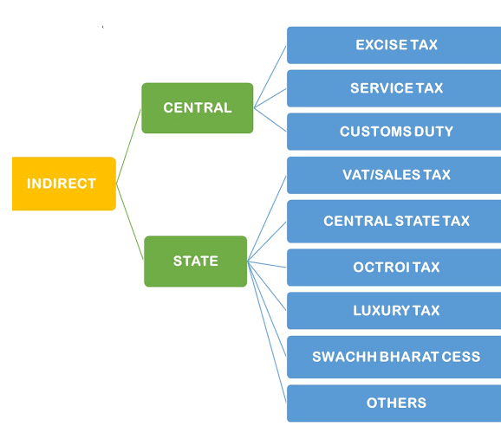
Existing Tax Regime
Before GST implementation we had several type of taxes.
Such as -----------------

Slide 11
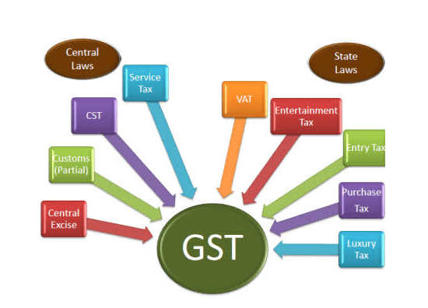
GST Implementation
The goods and services tax (GST) is an indirect tax which is introduced on 1st July’2017 replaced to certain taxes and it is applied to the cost of certain goods and services. The business adds the GST to the price of the product, and a customer who buys the product pays the sales price inclusive of the GST. The GST portion is collected by the business or seller and forwarded to the government.

Slide 12
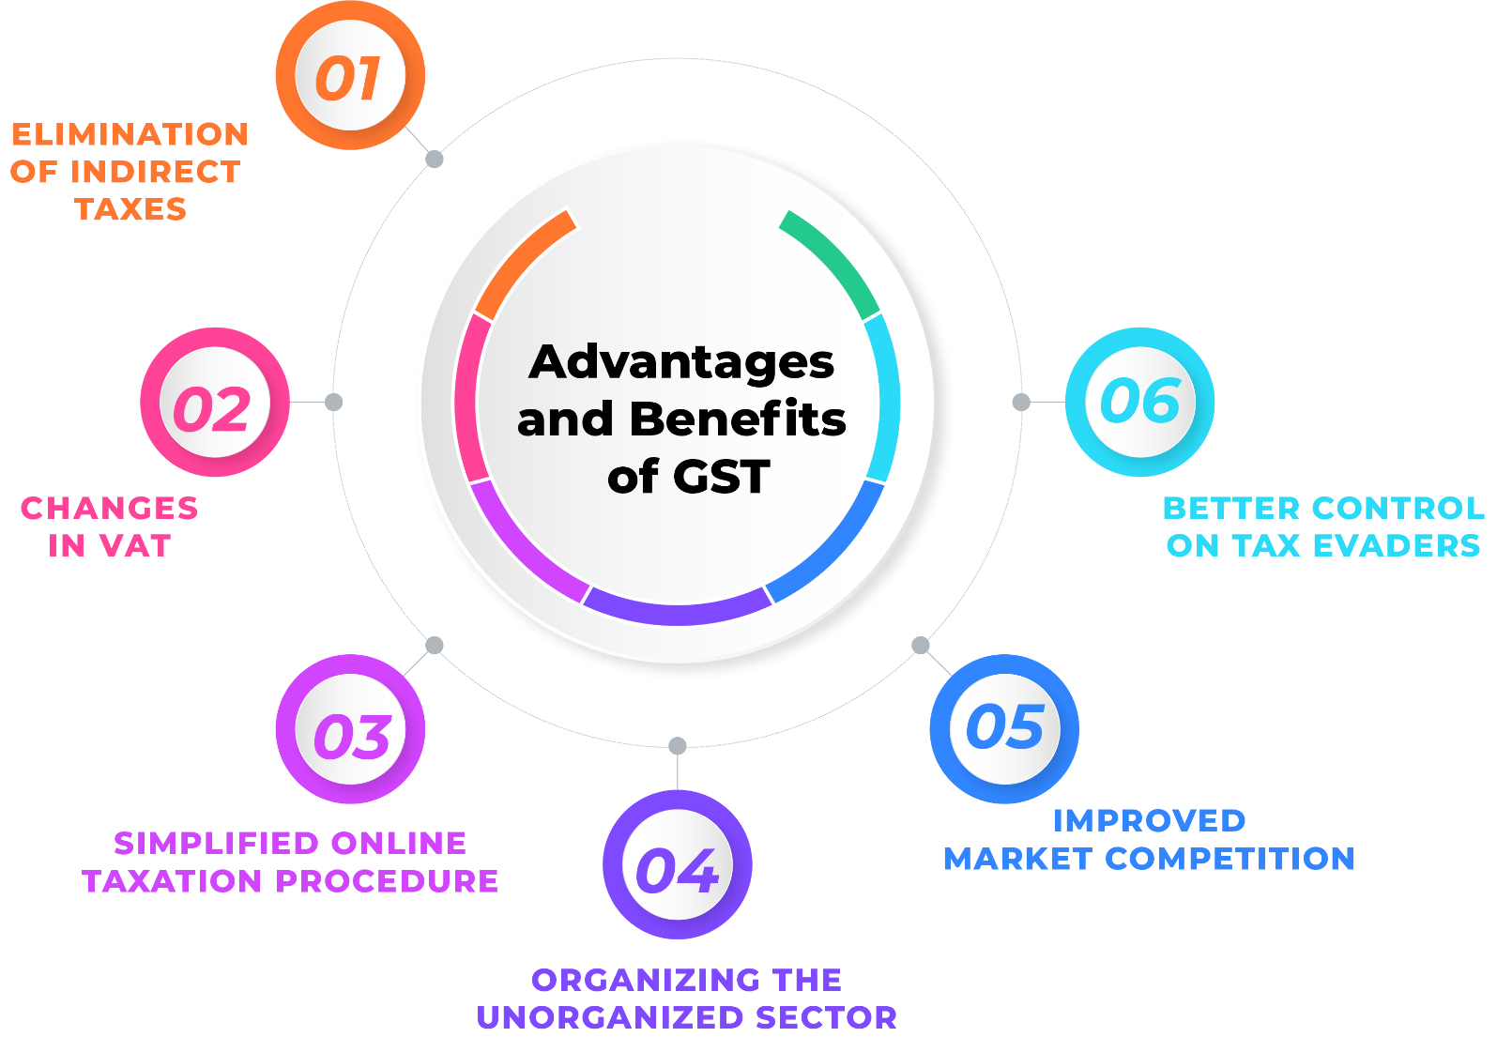
Benefits of GST Number
#1 Easy to Use Online Procedure.
#2 Higher Threshold for Registration.
#3 Easy Transportation of Goods for
E- commerce Companies.
#4 More Systematized & Regulated
Process.
#5 More Efficient Logistics. ...
#6 No More “Tax on Tax” ...

Slide 13
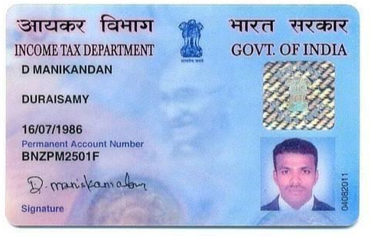
Pan Card
Know about pan card
A permanent account number (PAN) is a ten-character alphanumeric identifier, issued in the form of a laminated "PAN card", by the Indian Income Tax Department, to any "person" who applies for it or to whom the department allots the number without an application.

Slide 14
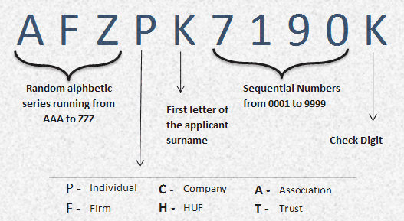
Pan Card Number Structure
The PAN (or PAN number) is a ten-character long alpha-numeric unique identifier.
The first five characters are letters (in uppercase by default), followed by four numerals, and the last character is a letter.
The first three characters of the code are three letters forming a sequence of alphabets letters from AAA to ZZZ
The fourth character identifies the type of holder of the card. Each holder type is uniquely defined by a letter from the list below:
Where the fourth character is "P" or of the name of the entity, trust, society, or organisation in the case of a company/HUF/firm/AOP/trust/BOI/local authority/artificial judicial person/government, where the fourth character is "C", "H", "F", "A", "T", "B", "L", "J", "G".

Slide 15
Pan Card Number Structure
The fourth character identifies the type of holder of the card. Each holder type is uniquely defined by a letter from the list below:
A — Association of persons (AOP)
B — Body of individuals (BOI)
C — Company
F — Firm
G — Government
H — HUF (Hindu undivided family)
L — Local authority
J — Artificial juridical person
P — Individual or Person
T — Trust (AOP)
The fifth character of the PAN is the first character of either:
of the surname or last name of the person, in the case of a "personal" PAN card.
The last character is an alphabetic digit used as a check-sum.

Slide 16
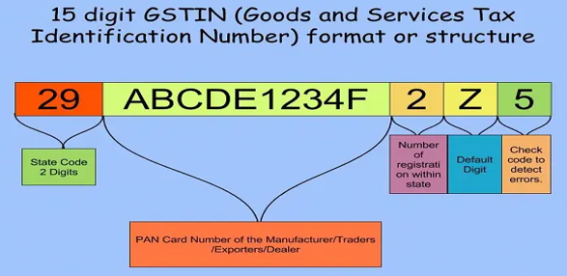
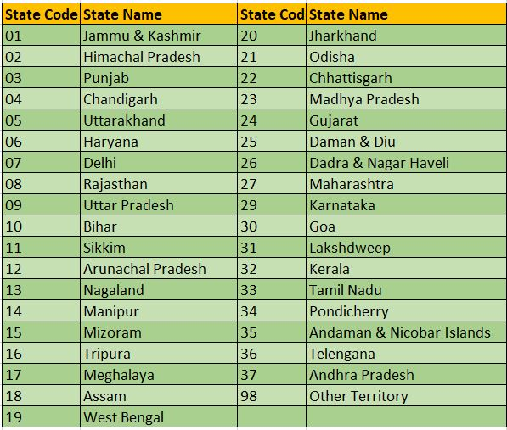
GST Identification Number Format
Every assessee (Taxpayer) will be given a state-wise PAN-based Goods and Services Taxpayer Identification Number (GSTIN) which will be of 15 digits

Slide 17
GST Identification Number
Description
Every assessee will be given a state-wise PAN-based Goods and Services Taxpayer Identification Number (GSTIN) which will be of 15 digits
First, two digits of the GSTIN will be representing the state code according to Indian Census 2011. Which says that every state will have a unique two digit code like for example “27” for Maharashtra and “10” for Bihar
Next ten digits of GSTIN will be the PAN number of the taxpayer
13th digit indicates the number of registrations an entity has within a state for the same PAN
It will be an alpha-numeric number (first 1-9 and then A-Z) and will be assigned on the basis of a number of registrations a legal entity (having the same PAN) has within one state
The fourteenth digit at present has no use and therefore will be “Z” by default
The last digit will be a check sum code which will be used for identification of errors by the means of sum up

Slide 18
Type of Taxpayers & Returns applicability
Regular
Casual
SEZ
Composition
ISD
NRTP
TDS
GSTR-5
GSTR-7
GSTR-1
GSTR-9
GSTR-6
TCS
CMP-08
GSTR-2A
GSTR-9C
GSTR-4
GSTR-2B
GSTR-8
GSTR-10
OIDAR
GSTR-3A
UIN Holders
GSTR-11
GSTR-3B
GSTR-5A
17-July 2024

Slide 19


Regular Taxpayer
Regular Taxpayers
Annual Aggregate Turn Over Limit is 40 Lakh to take compulsory GST Registration till 40 lakhs is completely optional
Regular taxpayers are eligible to Make outward supplies inter state ( Outside of state ) or Intra state ( Within state ) and eligible to file form GSTR-3B and GSTR-1 on a Monthly/Quarterly basis.
Regular taxpayers are eligible to raise Taxable Invoice.
Regular Taxpayers are eligible to claim Input tax credit on supplies received.
Regular taxpayers are eligible to outward supplies in pan India also export.
Government

Slide 20
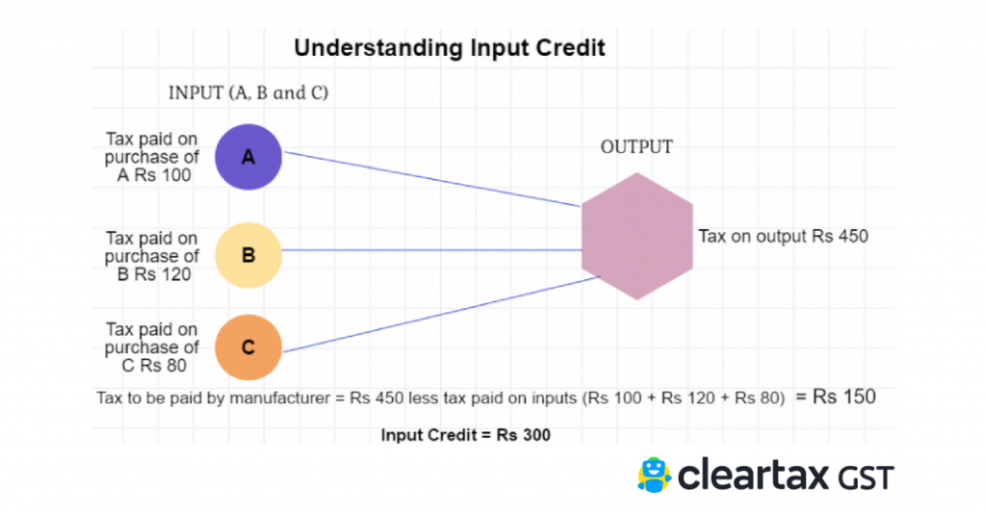
Explain of Input Tax Credit
In the context of GST (Goods and Services Tax), ITC stands for Input Tax Credit. It is a mechanism that allows businesses to offset the tax they have paid on inputs (purchases) against the tax they collect on outputs (sales).

Slide 21
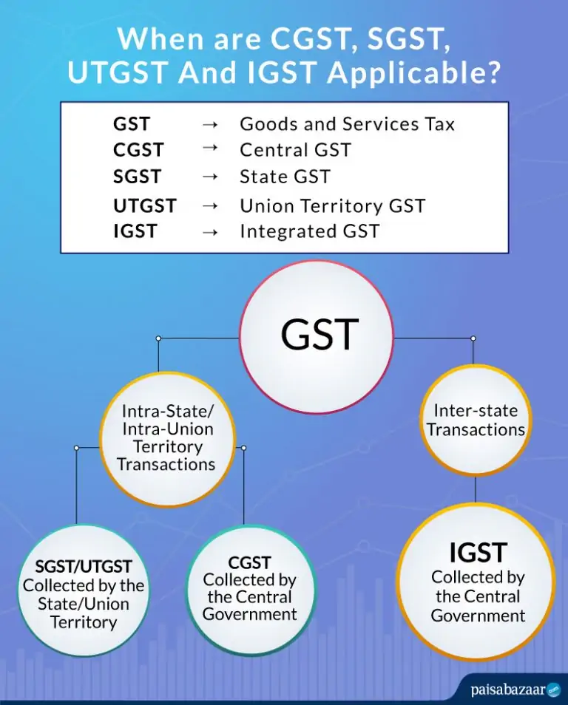
CGST / SGST / IGST AND UTGST
CGST is the tax collected by the Central Government on an intra-state supply of goods and services.
SGST is the tax collected by the State Government on an intra-state supply of goods and services. GST is the tax collected by the Central Government on an inter-state supply of goods and services (i.e., from one state to another). UTGST is similar to SGST but applies to the Union Territories of India .

Slide 22
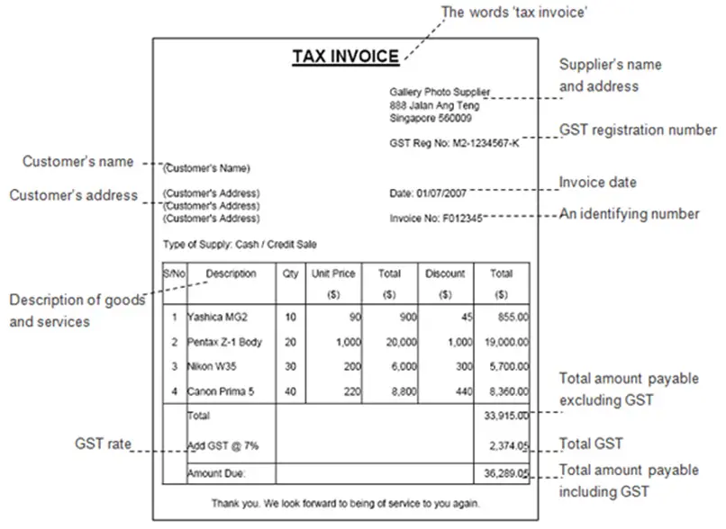
Taxable Invoice
A taxable invoice refers to a document issued by a supplier to a recipient when a taxable supply of goods or services has been made. In the context of GST (Goods and Services Tax) or any similar tax system, a taxable invoice includes specific details that are necessary for the recipient to claim input tax credit (ITC) or to determine the amount of tax payable.

Slide 23
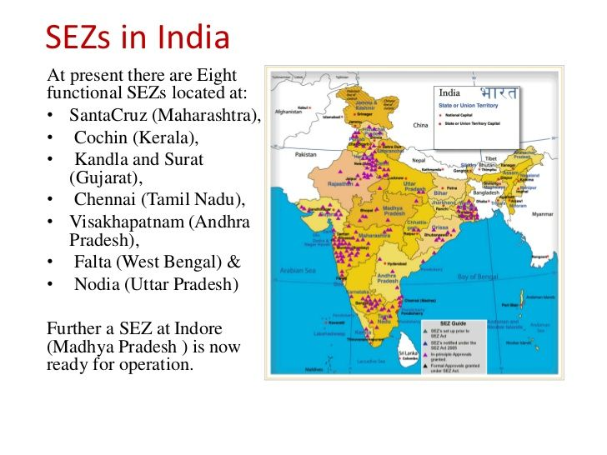
SEZ Taxpayer
SEZ Taxpayers
SEZ (Special Economic Zone) taxpayers refer to businesses or entities that operate within Special Economic Zones, which are designated geographical areas in a country that offer certain fiscal and regulatory incentives to promote industrial and commercial activities.

Slide 24
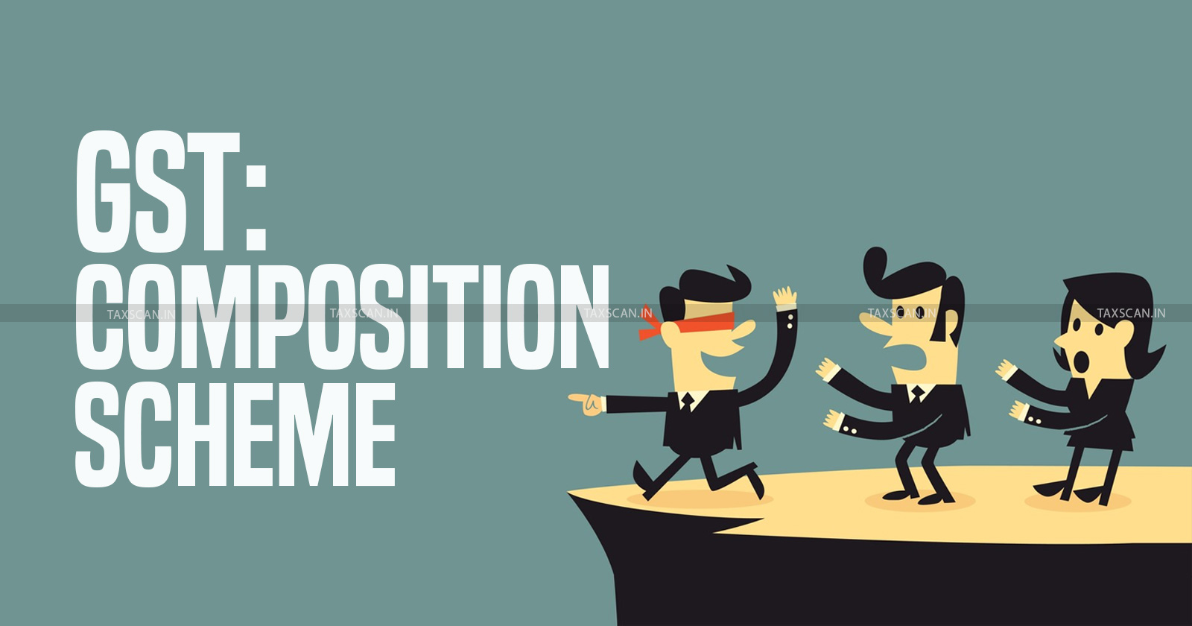
Composition Taxpayers
The composition scheme is introduced for small business owners with a turnover of up to Rs. 1.5 crores. While the GST rate can be up to 28% under the regular scheme, the composition scheme has capped the tax rate at 6% for eligible entities. The tax slabs under the composition scheme are 1% and 6%.
Restrictions are as below for composition taxpayers.
Annual Aggregate Turn Over Limit for composition is upto 1.5 Crores
Compositions taxpayers are not allowed to make inter state sale.
Compositions Taxpayers are not allowed to raise taxable Invoice rather they will issue bill of supply.
Composition Taxpayers are not eligible to claim Input Tax Credit ( ITC ) on supply received.
Composition taxpayers Needs to pay 1% or 6% tax on quarterly basis of aggregate sale.
Comp Taxpayers are not eligible for services except few.

Slide 25
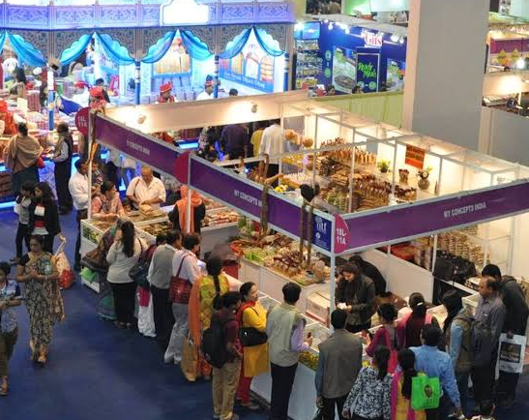
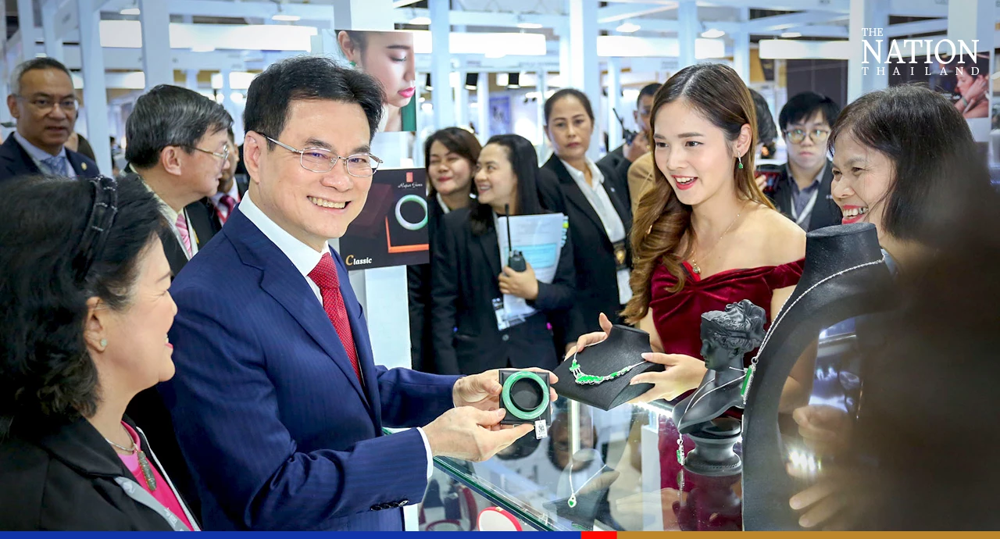
Casual and Non Residents Taxpayers
Casual Taxpayers
Casual taxable person means a person who supplies taxable goods or services occasionally in a taxable Territory where he does not have a fixed place of business. The person can act as a Principal or agent or in any other capacity supply goods or services for the furtherance of business.
Non Resident Taxable Person
Exhibition/Fair
Non-resident taxable person” means any person who occasionally undertakes transactions involving supply of goods or services or both, whether as principal or agent or in any other capacity, but who has no fixed place of business or residence in India.

Slide 26
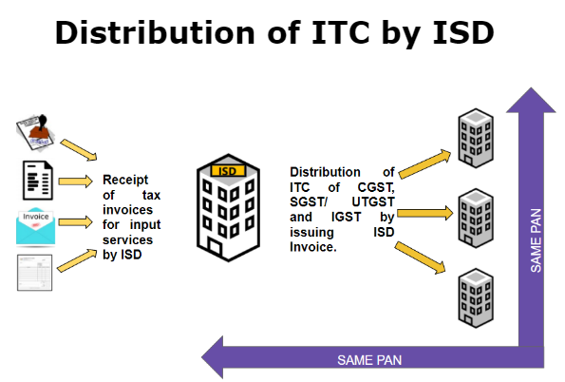



Input Service Distributors and OIDAR
Input Service Distributor
An Input service distributor (ISD) is a business which receives invoices for services used by its branches. It distributes the tax paid, to such branches on a proportional basis by issuing an ISD invoice
Every person supplying online information and database access or retrieval services from a place outside India to a person in India, other than the registered person (herein after referred to as Non-Resident Online Services Provider), is required to register in GST as a provider of OIDAR Services.
Example -

Slide 27



UIN Body/ Embassy/ (TDS) / (TCS)
Granting of Unique Identity Number Under GST Regime to UIN Body/ Embassy/ Other Notified Persons
Unique Identification Number, UIN, is a special class of GST registration for foreign diplomatic missions and embassies which are not liable to taxes in the Indian territory. Any amount of tax (direct or indirect) collected from such bodies is refunded back to them.
Tax Deductor at Source (TDS)
Tax Deducted at Source (TDS) is one of the ways to collect tax based on certain percentages on the amount payable by the receiver on goods/services. The collected tax is a revenue for the government.
Tax Collectors at Source (TDS)
Tax Collected at Source (TCS) by e-commerce operators under GST is a specific provision that requires e-commerce platforms to collect tax at source from payments received by them on behalf of the suppliers selling goods or services through their platform.

Slide 28
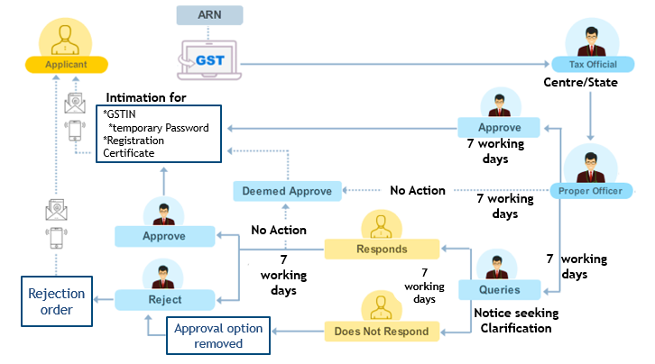
Registrations Flow (In case Aadhaar Authentication is Successful)

Slide 29
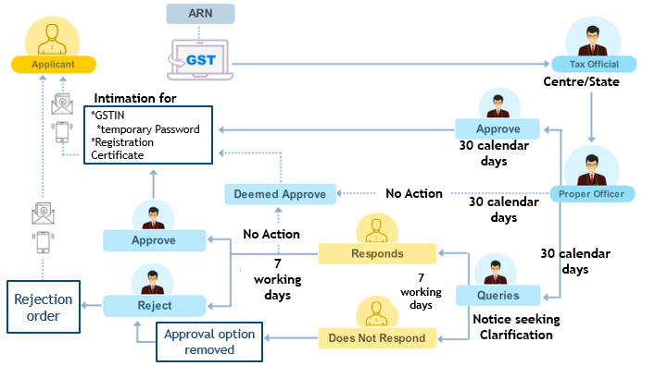
Registrations Flow (In case Aadhar Authentication gets Failed)

Slide 30
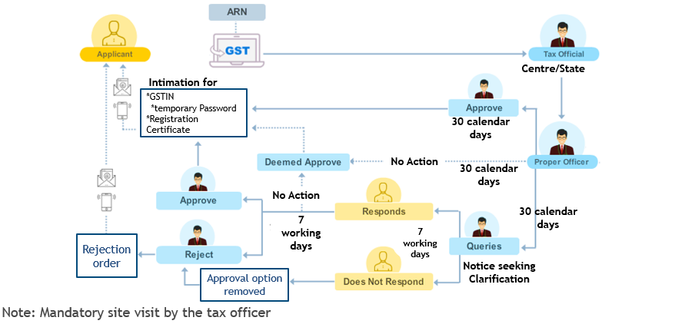
Registrations Flow (In case No is opted for Aadhar Authentication)

Slide 31
Script to be followed on call
Opening
Hold
Unhold
Further Assistance
Closing
Scripts adherence should be practiced on each and every calls.
Script | English
Opening | Welcome to GST Portal Helpdesk, my name is <Agent Name>. How may I assist/help you?
Hold | May I place your call on hold for a while.
Long Hold | Thank you for being on hold/line. I am still checking the information please be on hold/line/call
Long Hold Resume | Thank you for being on hold/call or Thank you for staying on line.
Further Assistance | Is there anything else I may assist you with?
Closing | Thank you for calling, I am transferring your call for feedback.
Script | Hindi
Opening | GST Portal Helpdesk mein aapka swagat hai, Mera naam (mein) XXX Hai, Mein aapki kis prakar se sahayta kar sakta/sakti huon?
Hold | Kya mein aapki call ko kuch samay ke liye hold par rakh sakti/sakta hu
Long Hold | Kripya line/hold/call per bane rahein/rahiye, information check karne mein kuch samay lag raha hai.
Long Hold Resume | Line/Call Hold karne ke liye dhanywaad or Line/call/Hold per bane rehne ke liye dhanyawaad.
Further Assistance | Kya aap kuch aur jaankari chahenge?
Closing | Feedback ke liye aapki call transfer ki ja rahi hai <Pause> Call karne ke liye dhanyawaad.

Slide 32
Zero Tolerance Policy
Please find the below points of Z.T Policy & Consequences, for all instances falling under this head, a disciplinary action ranging from a warning on the first instance to termination along with HR intervention would be applicable.
1. Abrupt call/chat disconnection intentionally.
2. Multiple call disconnections.
3. Being abusive with the customer.
4. Misusing customer's information (e.g., taking login ID & password, OTP, TRN, etc.).
5. Flirting with the customer.
6. Being rude, mocking, sarcastic, blunt, or impolite with the customer.
7. Crosstalk on-call (when an agent is talking to someone else while the customer is on the call, and the voice is being captured).
8. Providing personal information to the customer.
9. Not responding to the customer on-call (work avoidance).
10. Multiple call avoidances.
11. IVR transfer avoidance delay of 5 seconds.
12. Carrying a mobile phone, smart watch, paper, or notepad on the floor.
13. Soliciting or accepting customers’ credentials under any circumstance.
14. Sharing one's own or using someone else's credentials.
15. Call disconnection beyond hold duration.
16. Call disconnection beyond the opening timeline.
17. Any activity that is considered misconduct and can impact the client's business or visionplus's reputation.
18. Call disconnection from the customer's side after hold exceeded as per protocol.
19. Any unethical activity to reduce email/ticket productivity (work avoidance).
20. Rude, sarcastic, blunt, abusive, or unprofessional replies in email/ticket communication.
21. Escalation denial - denial for escalation only once positively stating that the same information will be provided by the senior.
Notes:
12-June-2024

Slide 33


